Slide 1
U.S. Supreme Court October Term 2017 Preview
Hon. David Stras
John Baker
Sybil Dunlop
Jeff Justman
Aaron Van Oort
October 18, 2017

Slide 2
Overview
High-profile cases in:
Constitutional Law
Federalism
Federal Statutory Claims
Criminal Law and Procedure
Patents

Slide 3
Constitutional Law

Slide 4
Constitutional Law
Masterpiece Cakeshop, Ltd. v. Colorado Civil Rights Commission
Whether a state public accommodations law compelling an individual to create an expression opposing religious beliefs about marriage violates the free speech or free exercise clauses of the First Amendment
Notes:
Masterpiece Cakeshop, Ltd. v. Colorado Civil Rights Commission
SCOTUS Blog: http://www.scotusblog.com/case-files/cases/masterpiece-cakeshop-ltd-v-colorado-civil-rights-commn/
Cert Petition: http://www.scotusblog.com/wp-content/uploads/2016/08/16-111-cert-petition.pdf

Slide 5
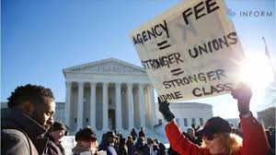
Constitutional Law
Janus v. State, County, and Municipal Employees, Council 31
Should Abood v. Detroit Bd. of Education be overruled?
Abood: upheld a requirement that members of public sector unions pay fees equivalent to union dues, to recover the cost of collective bargaining, contract administration, and grievance adjustment (but not for political purposes)
Does this requirement violate the First Amendment?
Court split 4-4 on this issue after Justice Scalia’s death

Slide 6
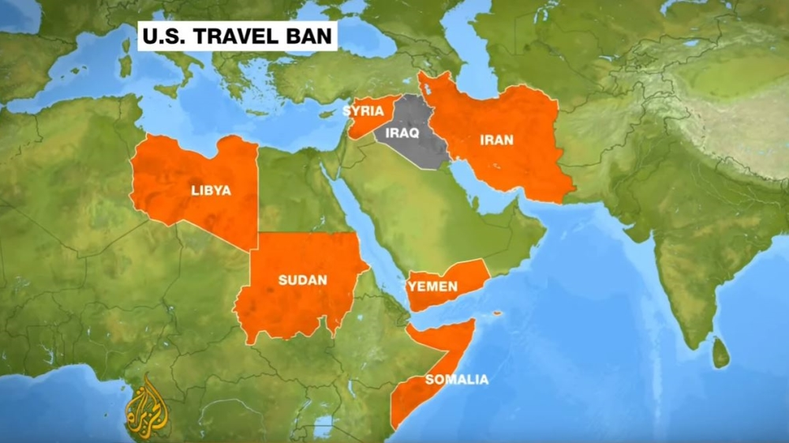
Constitutional Law
Trump v. Hawaii
Trump v. International Refugee Assistance Project
Executive Order No. 13,780: 90 Day entry suspension for foreign nationals from 6 countries that Congress or the President previously designated as presenting heightened terrorism-related risks
Notes:
Trump v. Hawaii
SCOTUS Blog: http://www.scotusblog.com/case-files/cases/trump-v-hawaii/
Trump v. International Refugee Assistance Project
SCOTUS Blog: http://www.scotusblog.com/case-files/cases/trump-v-international-refugee-assistance-project/
Cert Petition: http://www.scotusblog.com/wp-content/uploads/2017/06/16-1436-petition-trump-v.-irap.pdf

Slide 7
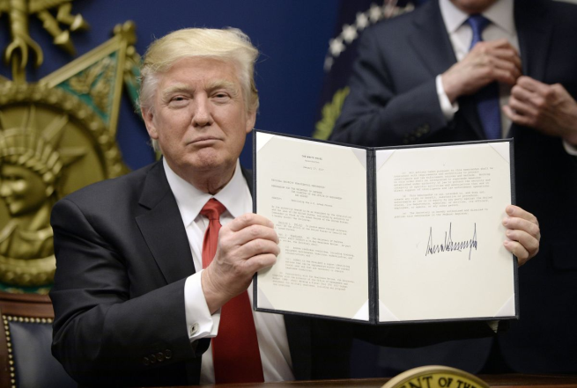
Constitutional Law
Trump v. Hawaii /Trump v. IRAP (cont.)
Whether respondents' challenge to the temporary suspension of entry of aliens abroad is justiciable
Whether campaign and other unofficial statements made outside the process of “crafting an official policy” may be used to establish unconstitutional motives
Whether temporary entry suspension violates the Establishment Clause
Whether the global injunction, which rests on alleged injury to a single individual plaintiff, is impermissibly overbroad

Slide 8
Federalism

Slide 9
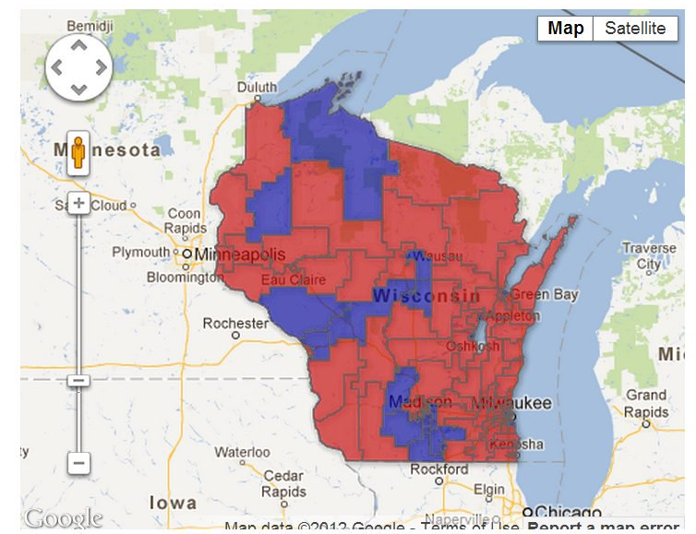
Federalism
Gill v. Whitford
Are partisan gerrymandering claims justiciable?
Does an impermissible partisan gerrymander exist if it was undisputed that the plan complies with traditional redistricting principles?
Whether the district court had the authority to entertain a challenge to the statewide redistricting plan, instead of a district-by-district analysis
2012 Wisconsin State Assembly Election
Notes:
Gill v. Whitford
Key Issues:
Whether the district court violated Vieth v. Jubelirer when it held that it had the authority to entertain a statewide challenge to Wisconsin's redistricting plan, instead of requiring a district-by-district analysis;
whether the district court violated Vieth when it held that Wisconsin's redistricting plan was an impermissible partisan gerrymander, even though it was undisputed that the plan complies with traditional redistricting principles;
whether the district court violated Vieth by adopting a watered-down version of the partisan-gerrymandering test employed by the plurality in Davis v. Bandemer;
whether the defendants are entitled, at a minimum, to present additional evidence showing that they would have prevailed under the district court's test, which the court announced only after the record had closed; and
whether partisan-gerrymandering claims are justiciable.
SCOTUS Blog: http://www.scotusblog.com/case-files/cases/gill-v-whitford/

Slide 10
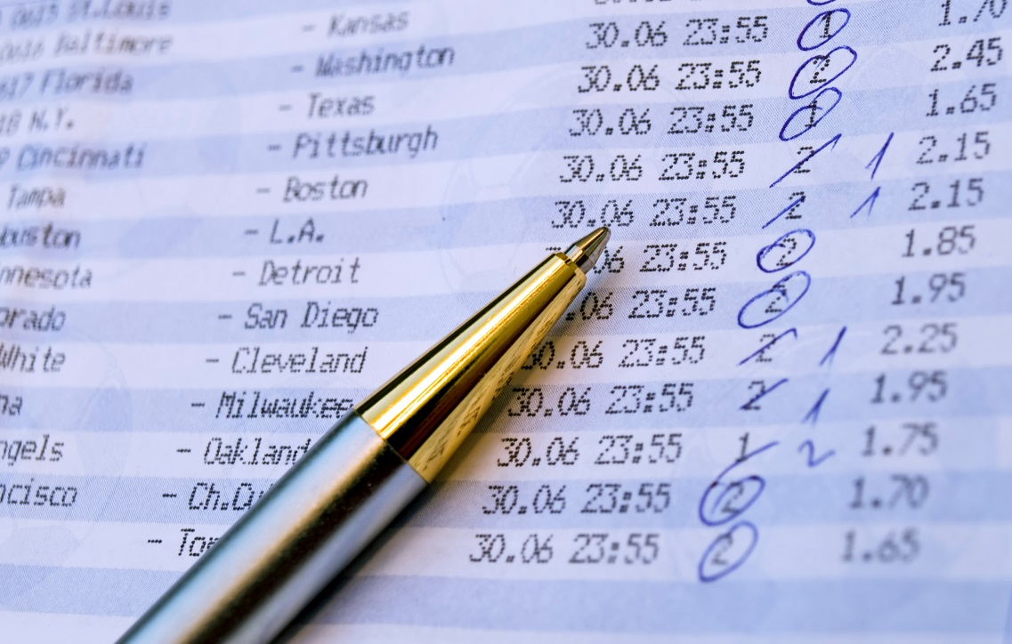
Federalism
Christie v. NCAA
New Jersey Thoroughbred Horsemen’s Association, Inc. v. NCAA
Whether a congressional prohibition against a state repealing existing sports wagering prohibitions impermissibly commandeers the regulatory power of states
Notes:
Christie v. National Collegiate Athletic Association
Issue: Whether a federal statute that prohibits modification or repeal of state-law prohibitions on private conduct impermissibly commandeers the regulatory power of states in contravention of New York v. United States?
SCOTUS Blog: http://www.scotusblog.com/case-files/cases/christie-v-national-collegiate-athletic-association-2/
Cert Petition: http://www.scotusblog.com/wp-content/uploads/2016/10/16-476-cert-petition.pdf
Carpenter v. United States
Issue: Whether a federal statute that prohibits adjustment or repeal of state-law prohibitions on private conduct impermissibly commandeers the regulatory power of states in contravention of New York v. United States and Printz v. United States?
SCOTUS Blog: http://www.scotusblog.com/case-files/cases/carpenter-v-united-states-2/
Cert Petition: http://www.scotusblog.com/wp-content/uploads/2016/10/16-402-cert-petition.pdf

Slide 11
Federal Statutory Claims
Cyan, Inc. v. Beaver County Employees Retirement Fund
Securities Act of 1933: concurrent state-court subject matter jurisdiction over claims, with limited exceptions.
Whether state courts lack subject matter jurisdiction over covered class actions that allege only federal securities claims
Notes:
Cyan, Inc. v. Beaver County Employees Retirement Fund
SCOTUS Blog: http://www.scotusblog.com/case-files/cases/cyan-inc-v-beaver-county-employees-retirement-fund/
Cert Petition: http://www.scotusblog.com/wp-content/uploads/2016/06/15-1439-petition.pdf

Slide 12
Federalism
Jesner v. Arab Bank, PLC
Alien Tort Statute 28 U.S.C. § 1350: “The district courts shall have original jurisdiction of any civil action by an alien for a tort only, committed in violation of the law of nations or a treaty of the United States.”
Whether the Alien Tort Statute categorically forecloses corporate liability?
Notes:
Jesner v. Arab Bank, PLC
SCOTUS Blog: http://www.scotusblog.com/case-files/cases/jesner-v-arab-bank-plc/
Cert Petition: http://www.scotusblog.com/wp-content/uploads/2016/10/16-499-cert-petition.pdf

Slide 13
Federal Statutory Claims

Slide 14
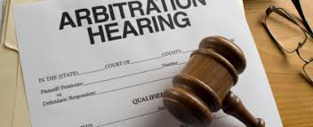
Federal Statutory Claims
Epic Systems Corp. v. Lewis
Ernst & Young LLP v. Morris
National Labor Relations Board v. Murphy Oil USA, Inc.
Agreement required an employee to arbitrate claims against an employer on an individual, rather than collective, basis.
Whether the collective-bargaining provisions of the National Labor Relations Act prohibit enforcement of agreements to arbitrate under the Federal Arbitration Act?
Notes:
Epic Systems Corp. v. Lewis
Specific Issue: It asks whether Section 7 of the NLRA, which gives employees the right to “engage in concerted activities for the purpose of collective bargaining or other mutual aid or protection,” 29 U.S.C. § 157, qualifies as a contrary congressional command sufficient to overcome the FAA’s presumption that these agreements should be enforced according to their terms.
SCOTUS Blog: http://www.scotusblog.com/case-files/cases/epic-systems-corp-v-lewis/
Cert Petition: http://www.scotusblog.com/wp-content/uploads/2016/09/16-285-cert-petition.pdf
Ernst & Young LLP v. Morris
SCOTUS Blog: http://www.scotusblog.com/case-files/cases/ernst-young-llp-v-morris/
Cert Petition: http://www.scotusblog.com/wp-content/uploads/2016/09/16-300-cert-petition.pdf
National Labor Relations Board v. Murphy Oil USA, Inc.
SCOTUS Blog: http://www.scotusblog.com/case-files/cases/national-labor-relations-board-v-murphy-oil-usa-inc/
Cert Petition: http://www.scotusblog.com/wp-content/uploads/2016/10/16-307-cert-petition.pdf

Slide 15
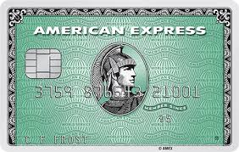
Federal Statutory Claims
Ohio v. American Express Co.
American Express has rules that prevent merchants from steering customers to credit cards with lower fees
U.S. government and 11 states sued American Express, saying this anti-steering rule was anti-competitive
Whether, under the “rule of reason,” the government’s showing that American Express’ anti-steering provisions stifle price competition suffices to prove anti-competitive effects
Amount at stake: 22 billion credit card transactions in 2011; retailers pay credit-card companies $50 billion in fees each year
Notes:
Digital Realty Trust, Inc. v. Somers
SCOTUS Blog: http://www.scotusblog.com/case-files/cases/digital-realty-trust-inc-v-somers/
Cert Petition: http://www.scotusblog.com/wp-content/uploads/2017/05/16-1276-cert-petition.pdf

Slide 16
Federal Statutory Claims
Rubin v. Islamic Republic of Iran
Plaintiffs want to satisfy judgment by seizing ancient Persian artifacts that have been on loan to the University of Chicago since the 1930s.
Whether the Foreign Sovereign Immunities Act, 28 U.S.C. § 1610(g), permits seizure if property at issue is used for commercial activity and when the plaintiff has obtained a judgment against a “terrorist party”
Whether FSIA provides a freestanding attachment immunity exception allowing terror victim judgment creditors to attach and execute upon assets of foreign state sponsors of terrorism
Notes:
Rubin v. Islamic Republic of Iran
SCOTUS Blog: http://www.scotusblog.com/case-files/cases/rubin-v-islamic-republic-of-iran-2/
Cert Petition: http://www.scotusblog.com/wp-content/uploads/2016/10/16-534-cert-petition.pdf

Slide 17
Federal Statutory Claims
Digital Realty Trust, Inc. v. Somers
Whether the anti-retaliation provision for “whistleblowers” in the Dodd-Frank Wall Street Reform and Consumer Protection Act of 2010 extends to individuals who have not reported alleged misconduct to the Securities and Exchange Commission and thus fall outside the act’s definition of “whistleblower.”
Notes:
Digital Realty Trust, Inc. v. Somers
SCOTUS Blog: http://www.scotusblog.com/case-files/cases/digital-realty-trust-inc-v-somers/
Cert Petition: http://www.scotusblog.com/wp-content/uploads/2017/05/16-1276-cert-petition.pdf

Slide 18
Criminal Law and Procedure

Slide 19
Preview: Carpenter v. United States
Facts:
During an investigation into a series of armed robberies, the government obtained an order for Carpenter’s cell phone records.
The order was based upon the Stored Communications Act (SCA), which allows such an order when there are “reasonable grounds” to believe that the records sought are relevant and material to the criminal investigation.
The cellphone records revealed the location of the cell towers with which Carpenter’s phone was connected at the beginning and end of each call.
Based on this information, Carpenter was indicted for the robberies.
Before trial, Carpenter moved to suppress the records, arguing that the SCA’s “reasonable grounds standard” was unconstitutional under the Fourth Amendment.

Slide 20
Preview: Carpenter v. United States
Holdings:
District Court: Denied Carpenter’s motion because obtaining the cell-site records was not a Fourth Amendment search.
Sixth Circuit: Affirmed.
Carpenter had no reasonable expectation of privacy in cellphone location records.
The cellphone companies collected the data in the ordinary course of business for their own purposes.
Issue: Whether the warrantless seizure and search of historical cellphone records revealing the location and movements of a cellphone user over the course of 127 days is permitted by the Fourth Amendment?

Slide 21
Criminal Law and Procedure
Two new cases also raising technological issues (granted this week):
United States v. Microsoft Corp.
Microsoft had emails about suspect on servers in Ireland; U.S. law enforcement agency served warrant for those emails; Microsoft resisted.
Whether law enforcement agencies can use a probable cause warrant under the Stored Communications Act to force U.S. companies to turn over customer data stored in a foreign data center
Dahda v. United States
Most of evidence used against Dahda in marijuana distribution conviction was obtained from wiretap of cellphone but when it was used outside the jurisdiction
Whether evidence should be suppressed when a trial court allows wiretapping of mobile phones outside its jurisdiction

Slide 22
Preview: District of Columbia v. Wesby
Facts:
Officers entered the house after receiving a complaint about a loud party taking place in a vacant home.
Officers found the house in “disarray,” unfurnished, and 21 people partying inside. No one knew who owned the house, but several of the partygoers said they were invited by a woman named “Peaches,” who was at the party and then left.
Peaches admitted that she did not have the owner’s permission to use the home. Officers also called the owner, who said the home was vacant and no one had permission to be there.
Based on this information, officers arrested those present at the party for trespassing.
Arrestees brought suit against the officers, claiming they violated the Fourth Amendment because their arrests lacked probable cause under a DC unlawful-entry law, which required that the trespassers knew, or should have known, that they entered the house against the owner’s will.

Slide 23
Preview: District of Columbia v. Wesby
Holdings:
District Court: Granted summary judgment in favor of the arrestees.
No probable cause existed because there was no evidence that the partygoers knew or should have known that they entered against the owner’s will.
Officers were not entitled to qualified immunity because their actions were not objectively reasonable.
D.C. Circuit: Affirmed on both grounds.
No probable cause existed because the woman invited the partygoers and the homeowner never told anyone that they were unwelcome in the home.
No qualified immunity because controlling case law at the time was clear that probable cause required evidence that the partygoers knew or should have known that they entered against owner’s will.
D.C. Circuit: Denied rehearing en banc.

Slide 24
Preview: District of Columbia v. Wesby
Issues:
1. Whether police officers who found late-night partiers inside a vacant home belonging to someone else had probable cause to arrest the partiers for trespassing under the Fourth Amendment?
2. Whether, when the owner of a vacant home informs police that he has not authorized entry, an officer assessing probable cause to arrest those inside for trespassing may discredit the suspects' questionable claims of an innocent mental state?
3. Whether, even if there was no probable cause to arrest the apparent trespassers, the officers were entitled to qualified immunity because the law was not clearly established in this regard?

Slide 25
Preview: Sessions v. Dimaya
Facts:
The Immigration and Nationality Act (INA) says that any alien who is convicted of an “aggravated felony” is removable from the United States.
“Aggravated felony” includes any “crime of violence,” as defined in 18 U.S.C. 16(b), for which the term of imprisonment is at least one year.
Section 16(b) defines “crime of violence” to include any offense that is a felony and that by its nature involves a substantial risk that physical force may be used in committing the offense.
Dimaya, who is a lawful permanent resident, was convicted of first-degree residential burglary on two separate occasions.
In 2010, the Department of Homeland Security initiated removal proceedings against Dimaya because the burglary convictions qualified as “aggravated felon[ies].”
Notes:
This case was argued in January of 2017 but no opinion was issued. The case was set for reargument on Monday, October 2, 2017. Justice Gorsuch will likely have an impact on this case.

Slide 26
Preview: Sessions v. Dimaya
Holdings:
Immigration Judge: Dimaya was removable because each conviction was an “aggravated felony.”
Board of Immigration Appeals: Dismissed Dimaya’s appeal. First-degree burglary is a “crime of violence” under Section 16(b) and therefore an aggravated felony.
Ninth Circuit: Section 16(b), as incorporated in the INA’s definition of “aggravated felony,” is unconstitutionally vague.
Issue: Whether 18 U.S.C. § 16(b), as incorporated into the Immigration and Nationality Act’s provisions governing an alien’s removal from the United States, is unconstitutionally vague?

Slide 27
Justice Gorsuch’s Potential Impact?
Then-Judge Gorsuch emphasized the need for citizens to have fair notice of the laws, especially in a modern era with an ever-increasing number of laws on the books.
In a 2013 speech, he stated: “Without written laws, we lack fair notice of the rules we must obey. But with too many written laws, don’t we invite a new kind of fair notice problem? And what happens to individual freedom and equality—and to our very conception of law itself—when the criminal code comes to cover so many facets of daily life that prosecutors can almost choose their targets with impunity? ... In Federalist 62, Madison warned that when laws become just a paper blizzard citizens are left unable to know what the law is and cannot conform their conduct to it. It is an irony of the law that either too much or too little can impair liberty.”
United States v. Rentz: Judge Gorsuch’s opinion for the court indicated his willingness to apply the rule of lenity—the rule that a grievously ambiguous criminal statute will be construed in the defendant’s favor—because it ensures that Congress provides fair notice to a criminal defendant of what conduct is illegal.
Notes:
DEA: see my email for the full passages, if you would prefer selecting different quotes. You could also cut the speech quote after “impunity” if you want to shorten it. Additionally, given the audience, I am not sure whether you need to define what the “rule of lenity” is.

Slide 28
Patents

Slide 29
Patents
Oil States Energy Services LLC v. Greene’s Energy Group, LLC
Is the statutorily created inter partes review (“IPR”) process unconstitutional?
Notes:
Oil States Energy Services LLC v. Greene’s Energy Group, LLC
SCOTUS Blog: http://www.scotusblog.com/case-files/cases/oil-states-energy-services-llc-v-greenes-energy-group-llc/
Cert Petition: http://www.scotusblog.com/wp-content/uploads/2017/06/16-712-petition.pdf

Slide 30
Patents
What is inter partes review?
Notes:
Oil States Energy Services LLC v. Greene’s Energy Group, LLC
SCOTUS Blog: http://www.scotusblog.com/case-files/cases/oil-states-energy-services-llc-v-greenes-energy-group-llc/
Cert Petition: http://www.scotusblog.com/wp-content/uploads/2017/06/16-712-petition.pdf

Slide 31
Patents
Are patent rights private-property rights or public rights?
Notes:
Oil States Energy Services LLC v. Greene’s Energy Group, LLC
SCOTUS Blog: http://www.scotusblog.com/case-files/cases/oil-states-energy-services-llc-v-greenes-energy-group-llc/
Cert Petition: http://www.scotusblog.com/wp-content/uploads/2017/06/16-712-petition.pdf

Slide 32
Patents
What happens if IPRs are unconstitutional?
What happens if IPRs are unconstitutional?
Notes:
Oil States Energy Services LLC v. Greene’s Energy Group, LLC
SCOTUS Blog: http://www.scotusblog.com/case-files/cases/oil-states-energy-services-llc-v-greenes-energy-group-llc/
Cert Petition: http://www.scotusblog.com/wp-content/uploads/2017/06/16-712-petition.pdf

Slide 33
Patents
SAS Institute Inc. v. Matal
Does the PTAB have to issue a final written decision as to every claim challenged or only some of the challenged claims?
Notes:
SAS Institute Inc. v. Matal
SCOTUS Blog: http://www.scotusblog.com/case-files/cases/sas-institute-inc-v-lee/
Cert Petition: http://www.scotusblog.com/wp-content/uploads/2017/02/16-969-cert-petition.pdf

Slide 34
Patents
If an inter partes review is instituted and not dismissed under this chapter, the Patent Trial and Appeal Board shall issue a final written decision with respect to the patentability of any patent claim challenged by the petitioner and any new claim added under section 316(d).
35 USC §318(a).
Notes:
SAS Institute Inc. v. Matal
SCOTUS Blog: http://www.scotusblog.com/case-files/cases/sas-institute-inc-v-lee/
Cert Petition: http://www.scotusblog.com/wp-content/uploads/2017/02/16-969-cert-petition.pdf

